Slide 1
Head First
Chapter-1:
Breaking the Surface - JAVA working process
Upcode Software
Engineer Team
-2023-

Slide 2
CONTENT
What is Java ?
Why Java is independent from any OS ?
How JAVA works and what happens behind the scenes ?
What is a JDK, JRE and JVM ?
Used materials and references

Slide 3
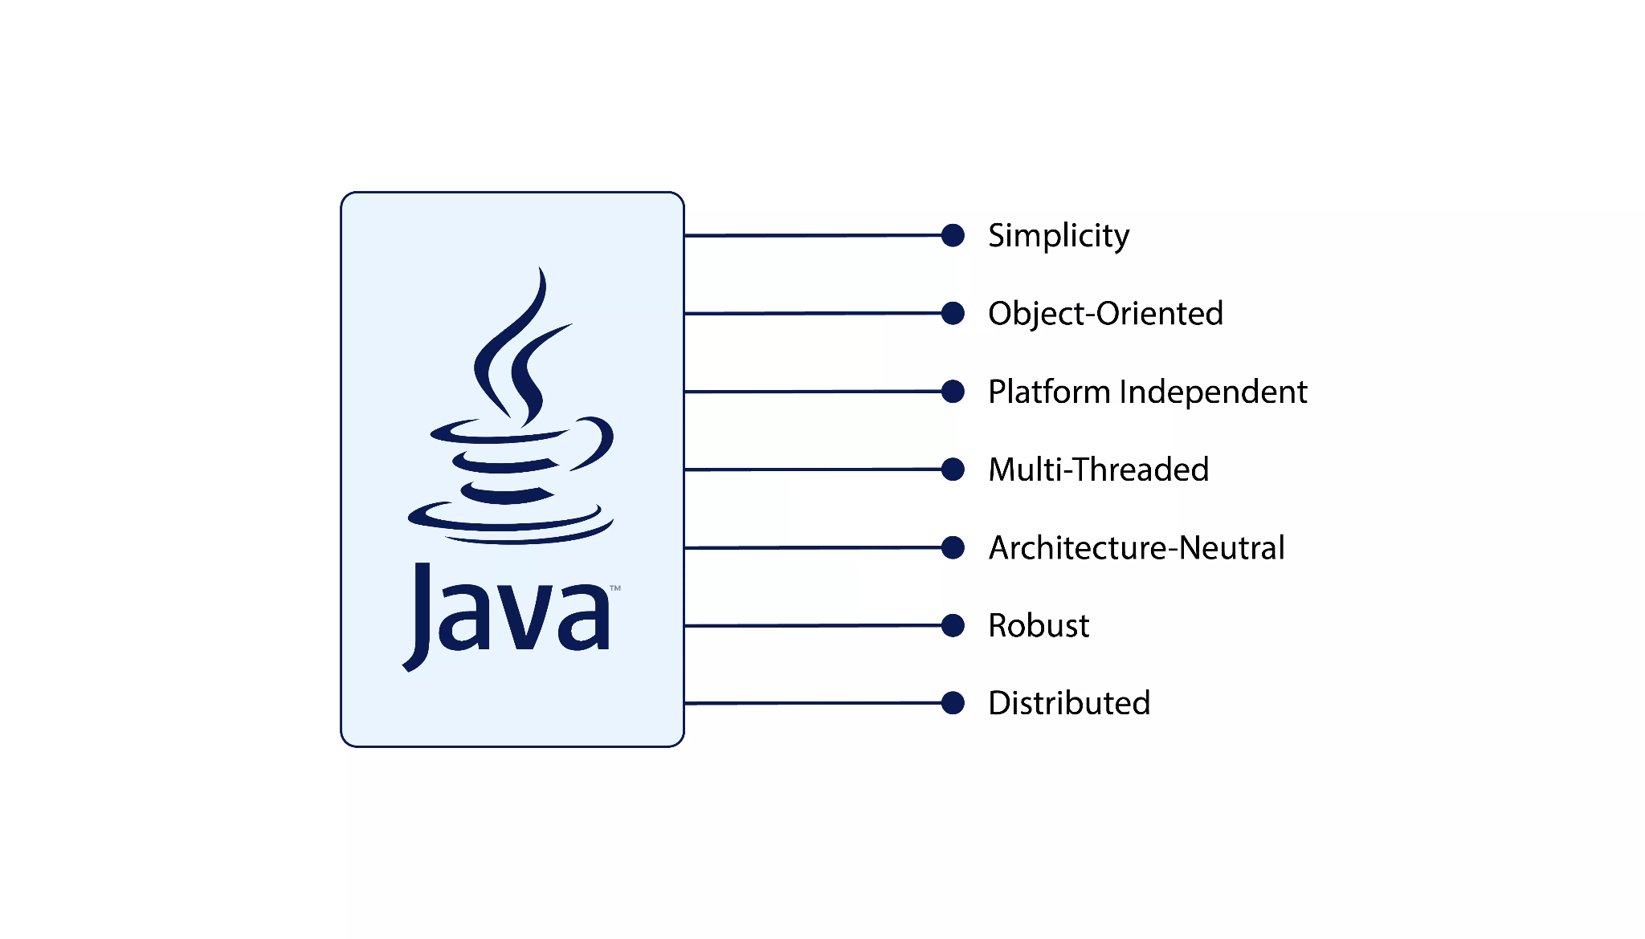
What is Java?
Java is a widely used object-oriented programming language and software platform that runs on billions of devices, including notebook computers, mobile devices, gaming consoles, medical devices and many others.
The rules and syntax of Java are based on the C and C++ languages.

Slide 4
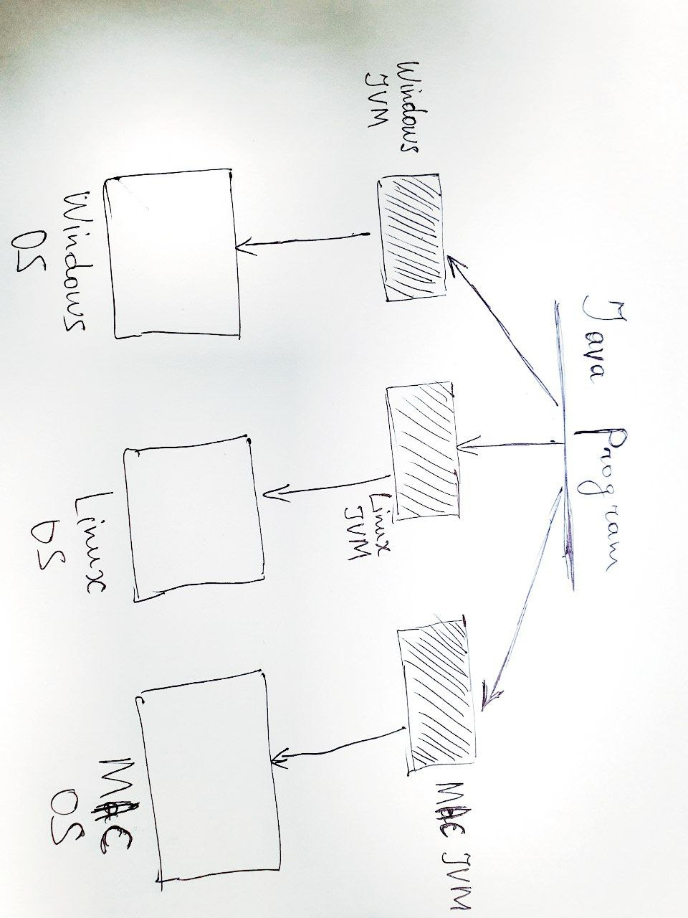
2. Why Java is independent from any OS

Slide 5
3. Why Java is independent from any OS
Java is platform-independent because it uses virtual machine.
Platform-independent languages like Java offer several advantages. Some of them are:
Portability
Programs can be written once and executed on multiple platforms, reducing development effort and maintenance.
Wider Audience
Platform-independent programs can reach a broader audience as they are not limited to a specific operating system or hardware architecture.

Slide 6
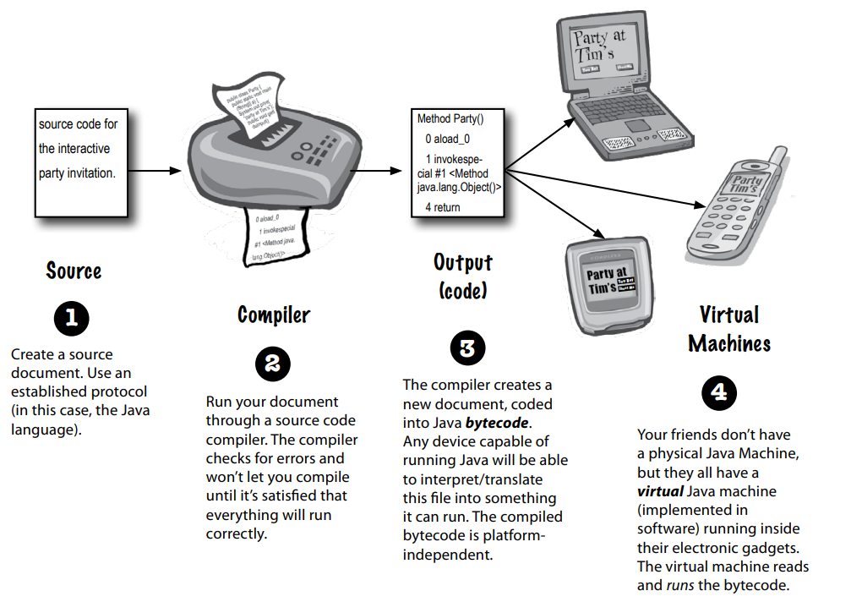
3. The How Java works and what happens behind the scenes?

Slide 7
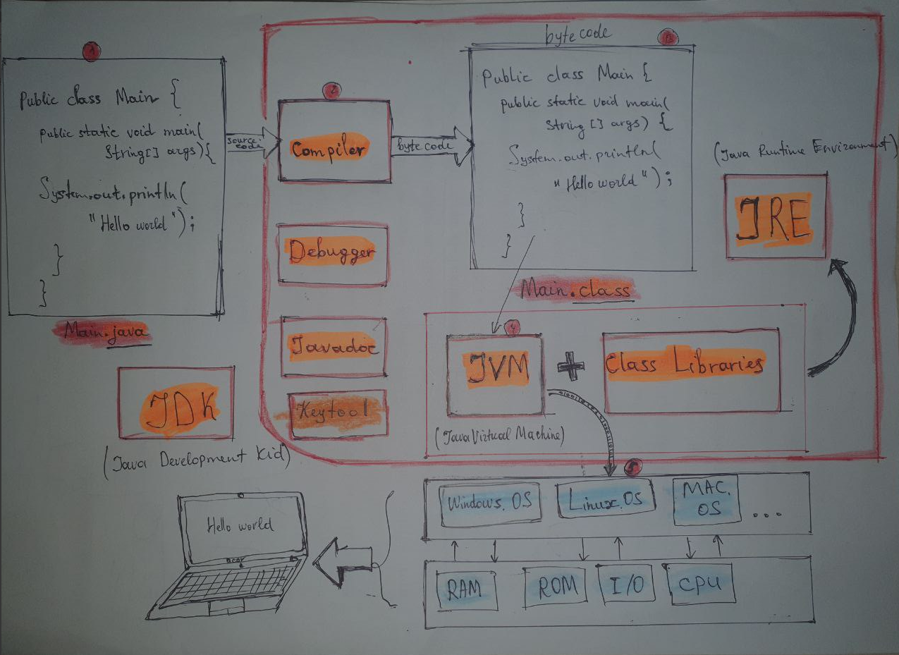
How to work JDK

Slide 8
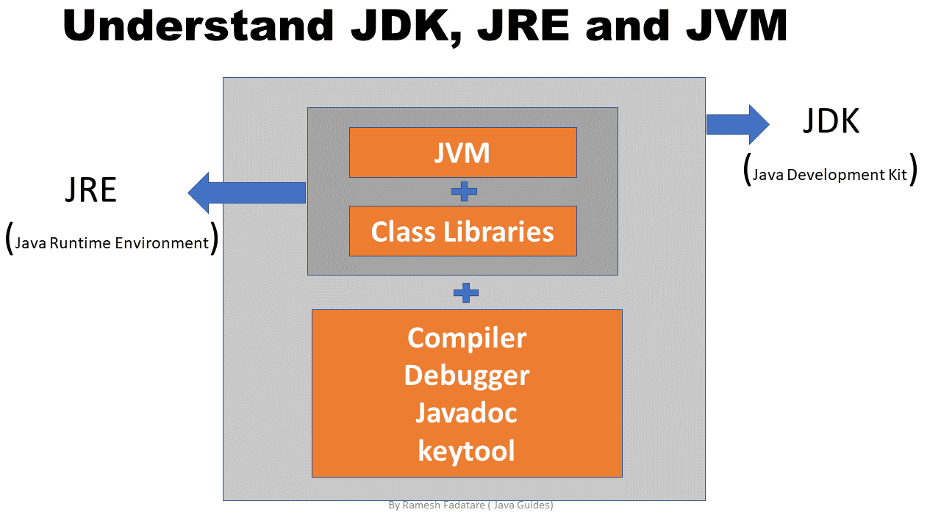
4. What is a JDK, JRE and JVM?

Slide 9
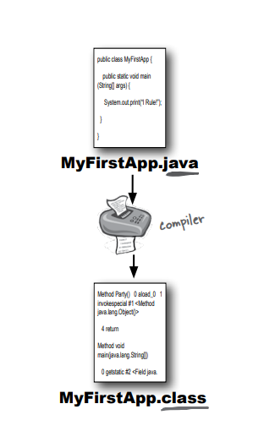
Why use JDK?
Important reasons to use JDK:
The JDK has a private JVM and a few other resources necessary for the development of a Java Application.
The JDK contains the necessary tools for writing Java programs and the JRE for running them.
It includes a Compiler
Java application launcher
It uses JRE to run applications developed in Java and JRE loads the necessary classes, and invokes its main methods.

Slide 10
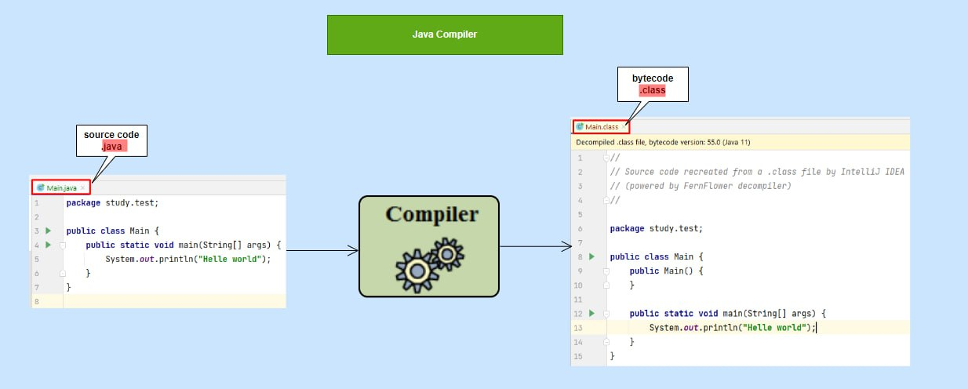
What does the compiler do?

Slide 11
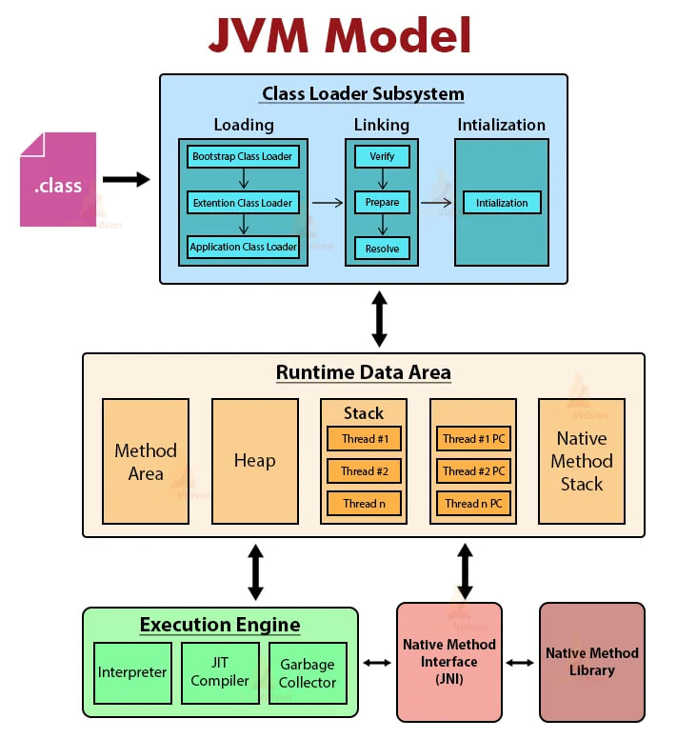
JVM Architecture

Slide 12
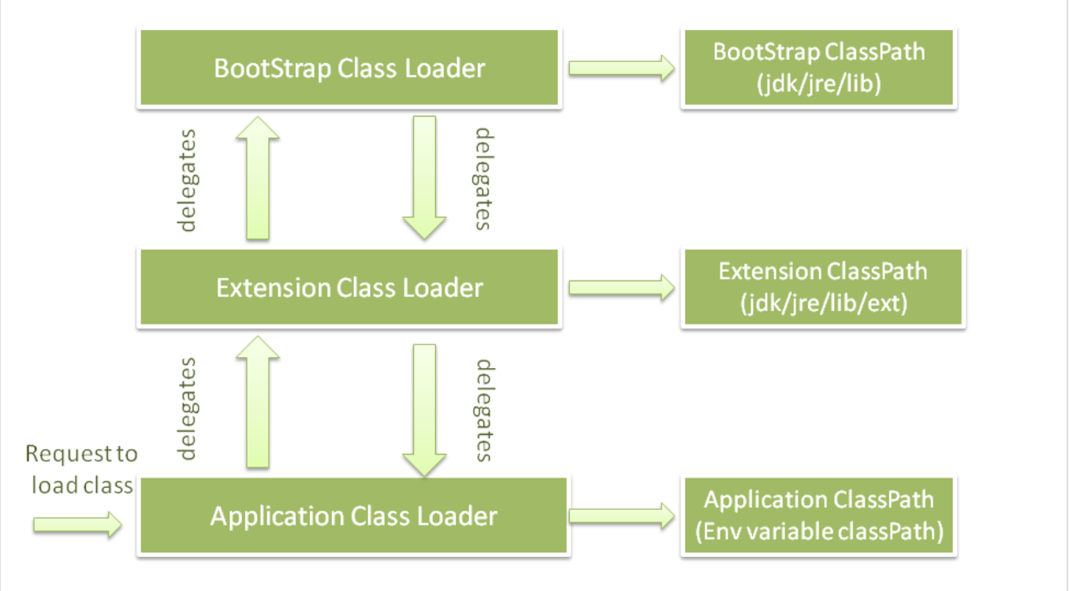
JVM Architecture
The JVM consists of three distinct components
Class Loader - Loaders of classes into memory
Runtime Data Area - the part of memory that stores data in the implementation process
Execution Engine - the part that performs actions

Slide 13
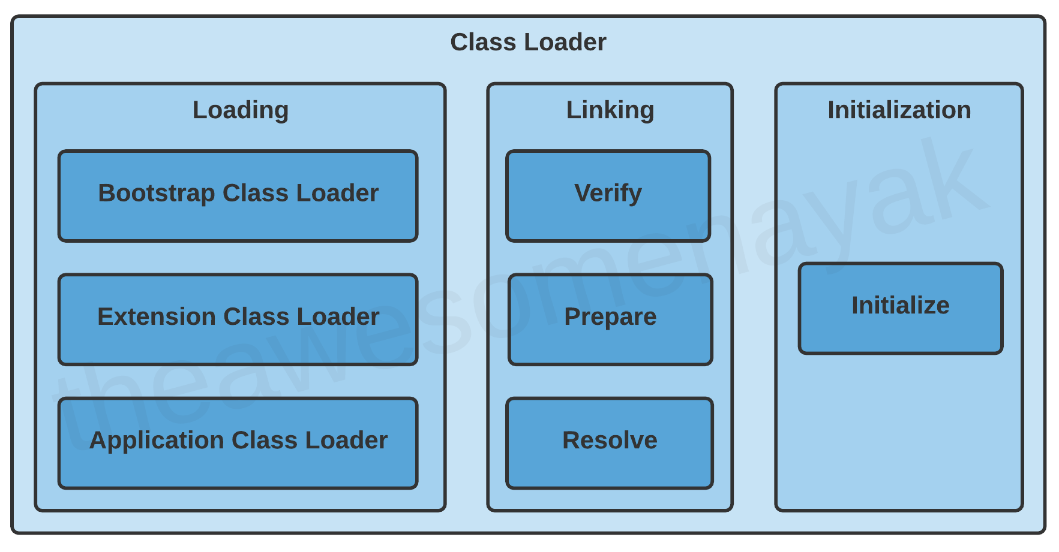
Class Loader Subsysteam
Classloader is a subsystem of JVM which is used to load class files.
Whenever we run the java program, it is loaded first by the classloader.
Classloaders have three main functions:
Loading
Linking
Initialization

Slide 14
Class Loader
Loading: Loading involves taking the binary representation (bytecode) of a class or interface with a particular name, and generating the original class or interface from that.
Linking: After a class is loaded into memory, it undergoes the linking process. Linking a class or interface involves combining the different elements and dependencies of the program together.
Initialization: Initialisation involves executing the initialization method of the class or interface. This can include calling the class's constructor, executing the static block, and assigning values to all the static variables. This is the final stage of class loading.

Slide 15
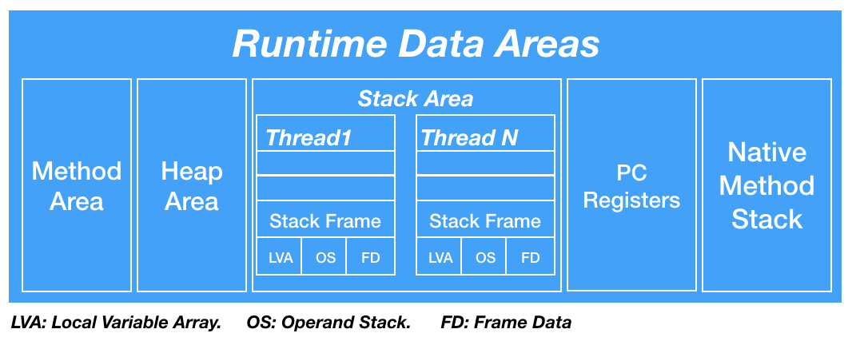
Runtime Data Area

Slide 16
Thank you!
Presented by
Temurmalik Nomozov
(temirmaliknomozov@gmail.com)

